Slide 1
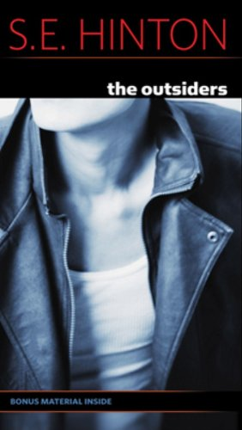
Summer Reading Project The Outsiders
Stephanie Henry

Slide 2
Identify which book you chose to read this summer and explain why you chose that particular book.
The Outsiders by S.E. Hinton
Fiction
Dell Publishing, New York City
1967
My brother read this book and loved it. He said there was a lot of action and really cool characters. HE HATES TO READ, so I figured if he loved it, the book must be awesome.

Slide 3
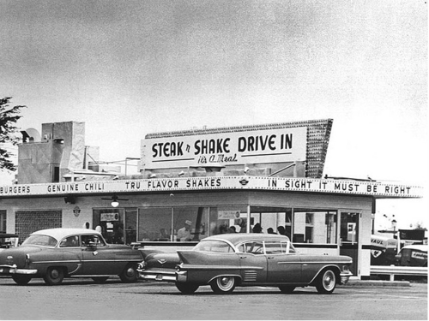
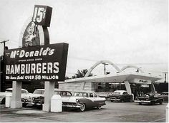
The Setting
Oklahoma in the 1960s
The setting has a large impact on the story because the time period itself was very dark and violent – and that darkness and violence seeps into the everyday lives of teenagers. In Oklahoma in the 1960s, there were a lot of people who were rich and people who were poor, and very little in the middle – this feeds into the conflict of the novel.
It was also a time of cool cars, drive-ins and cruising town!

Slide 4
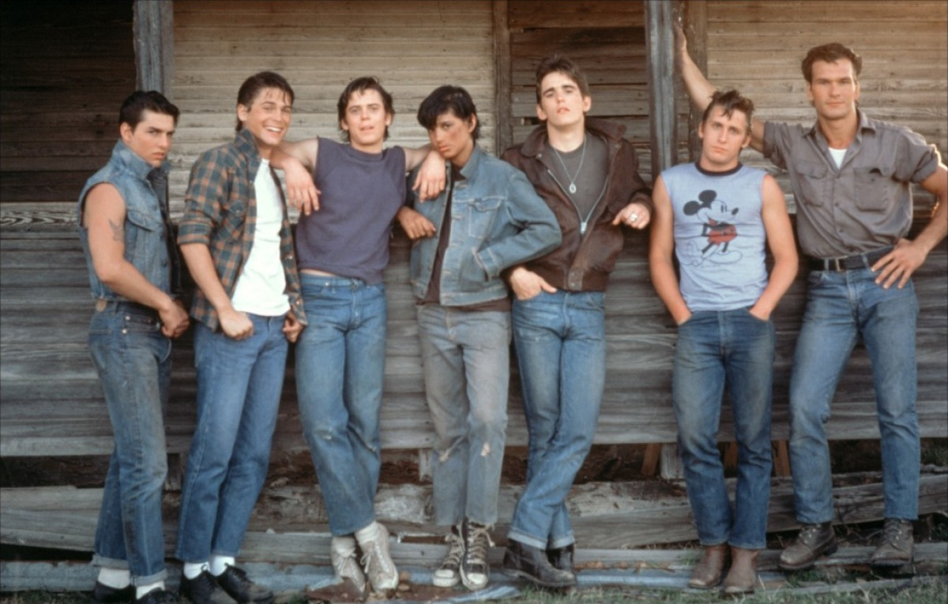
Character Descriptions
Ponyboy Curtis – Narrator, Greaser – lives with his two brothers, parents killed in car accident, very poor, but also smart and athletic.
Johnny Cade – Ponyboy’s best friend, smallest guy in the gang, almost killed by Socs in the past, parents are abusive and negligent.
Dallas Winston – Toughest/meanest guy in the Greaser gang, been in jail, violent, very protective of Johnny, street-smart
Cherry Valance – Soc girl – wants everyone to get along, kind to Greasers, but still a Soc

Slide 5
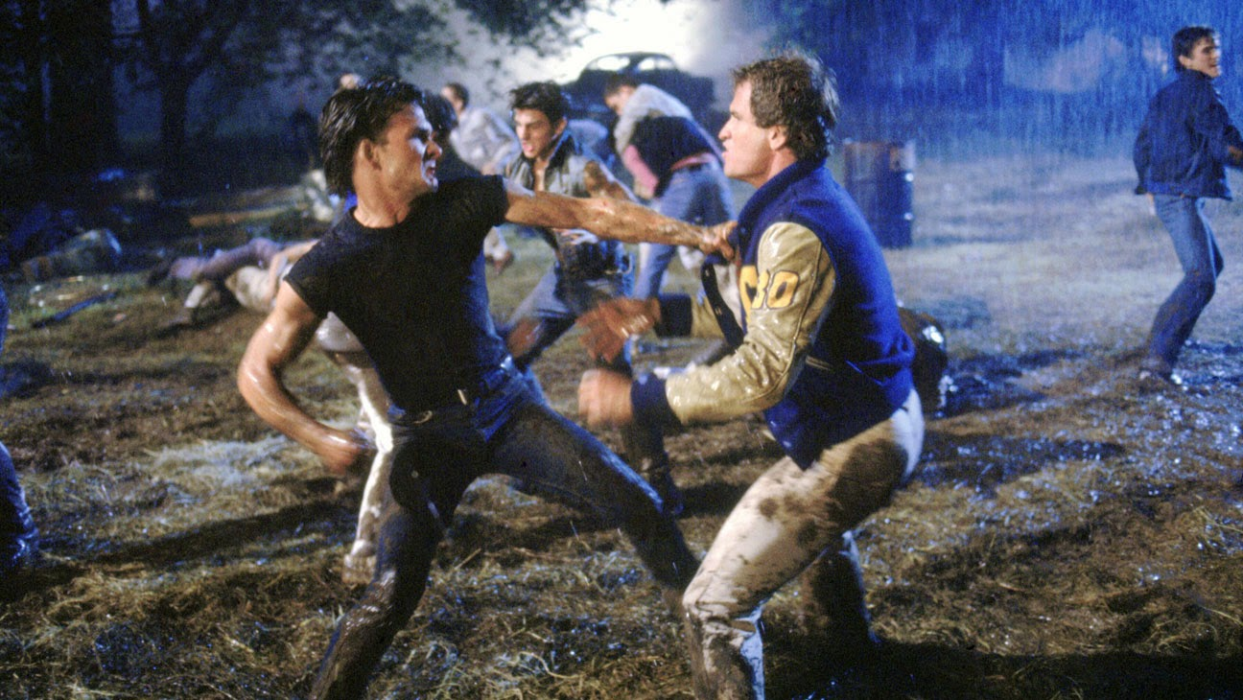
Conflicts
The main conflict in this novel is between the Greasers and the Socs – they are two groups of kids that don’t like each other.
This conflict gets worse when Johnny and Ponyboy are attacked by some Socs and Johnny kills one of them.

Slide 6
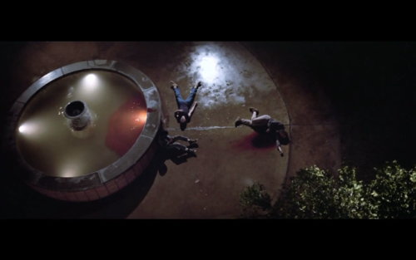
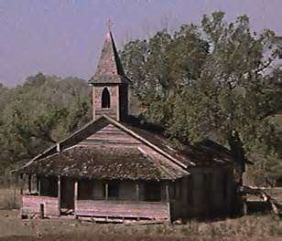
Main Events in the Novel
Ponyboy tells the story of Johnny’s attack to Cherry Valance at the drive-in.
Ponyboy gets in a fight with his brother and runs away.
Ponyboy and Johnny are attacked by the Socs and Johnny kills one of them.
Ponyboy and Johnny hiding out at the church.
The fire at the church.
The big rumble.

Slide 7
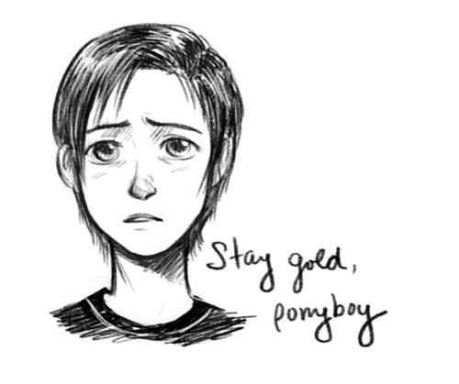
Themes/Lessons in the Novel
Don’t judge others – their life could be just as hard/easy as yours, you can’t know by just looking.
Everybody’s life is hard for different reasons – no one has it easy.
Try to find the good in the world – sunsets, friends, fun – there’s enough bad out there.
Stay pure, don’t let life make you bitter and hard – try to stay positive and look for the good.

Slide 8
Personal Critique
I absolutely LOVED this book. There were several characters, so it was easy to find one that I identified with and could feel their situation. The conflicts, even though they are from the 1960s are still problems today, so it was easy to understand the frustration and the conflict. The story also was fun to read because it had a lot of action and the pages turned fast!

